Slide 1
MAIS PRESENTATION
www.iou.edu.gm

Slide 2
About
Islamic Online University
2007
IOU Launched in Qatar
22 free diploma short courses
1,500 students registered
2010 March
First Tuition-free BA in Islamic Studies
30,000 students from
177 countries
2014 March
5 new departments opened
2016 May
250,000+ students
From 229 countries
www.iou.edu.gm
March

Slide 3
Founder
Dr. Bilal Philips
Jamaican – Canadian Islamic Scholar
Converted to Islam in early 70’s
BA Madeenah, MA Riyadh, PhD UK
Taught Arabic and Islamic Studies in
High Schools and Universities for 20 years
Set up Islamic Studies departments
Founded universities
Authored over 50 published books
One of the 500 most influential Muslims
in the world
www.iou.edu.gm

Slide 4
Mission
Authenticity
Accessibility
Affordability
Islamic Ethics
Community
Quality and Application
www.iou.edu.gm
March

Slide 5
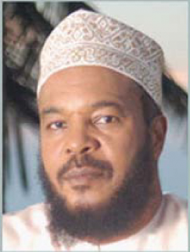
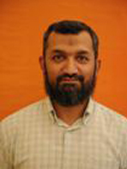
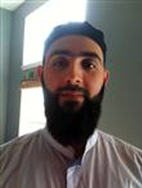
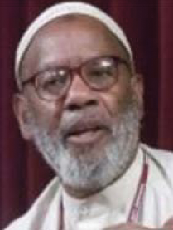
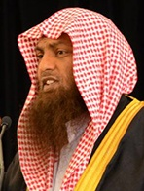
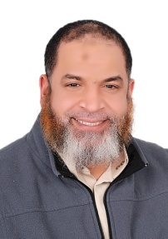
Some IOU Lecturers
Bilal Philips,
JAMAICA, W.I.
PhD
Theology
^{G Hussein} ^{Rassool}
^{M Monzur-E-Elahi}
^{BANGLADESH}
^{PhD}
^{Sharee’ah}
^{MAURITIUS}
^{PhD}
^{Psychology}
Daud Abdullah
GRENADA, W.I.
PhD
Seerah
^{Hooman Keshavarzi}
^{USA}
^{PhD}
^{Psychology}
^{Uvais Ahmed}
^{PAKISTAN}
^{PhD}
^{ICT}
James Jones
USA
PhD
Theology
^{Muhammad Ahsan}
^{UK}
^{PhD}
^{International}
^{Relations}
Francesca Bocca
ITALY
PhD
Psychology
M Anwar Sahib
FIJI
PhD
Fiqh
^{Abdoul Khadri Sillah}
^{The Gambia}
^{PhD}
^{Arabic}
^{Karim Abu Zaid}
^{EGYPT}
^{PhD}
^{Hadeeth}

Slide 6
IOU
DEPARTMENTS
& PROGRAMS
www.iou.edu.gm

Slide 7
Department of Islamic Studies
Department of Education
Department of Islamic Economics, Banking & Finance
Department of Psychology
Department of Business Administration (Fall 2014)
Department of Information Technology ICT (Fall 2014)
Department of Arabic Language and Linguistics
Department of TEFL
Department of Qur’an Memorization
Department of General Diploma in Islamic Studies
www.iou.edu.gm

Slide 8
Master of Arts (M.A.)
in Islamic Studies

Slide 9
Prerequisite
Minimum Requirements for MAIS degree applicants:
B.A. in Islamic Studies from an accredited institution or
B.A. (in a subject other than
Islamic Studies), B.Sc., B.Com, equivalent or higher along with BMAIS diploma from IOU.

Slide 10
Program length
Minimum two years and
maximum six years.
Three semesters of six subjects each
and a fourth semester for the
MA thesis.

Slide 11
MAIS
Curriculum
PSYCHOLOGY
EDUCATION
AQEEDAH
TAFSEER
HISTORY
FIQH
ARABIC
HADEETH

Slide 12
Year 1
SEMESTER I |  | SEMESTER II
CODE | DESCRIPTION | CODE | DESCRIPTION
AQD 501 | Tawheed Asmaa Wa Sifaat | AQD 502 | The Asha'irah
FQH 501 | Maqaasid Ash-Shariah | FQH 502 | Contemporary Fiqh Issues
TAF 501 | Tafseer I | TAF 502 | Tafseer II
ARB 501 | Arabic Morphology | HST 501 | History of the modern Muslim world
HAD 501 | Saheeh Al Bukhari: Chapter on Sales (Fat'hul Bari) | EDU 402 | Educational Administration
PSY 105 | Social Psychology | ARB 502 | Arabic Communication Skills

Slide 13
Year 2
SEMESTER III |  | SEMESTER IV
CODE | DESCRIPTION | CODE | DESCRIPTION
AQD 503 | Aqeedah III | THS 501 | MA Thesis
FQH 503 | International Relations
FQH 504 | Qada Wa Siyaa'sa Shar'eeyah
ARB 503 | Arabic Literature
HAD 502 | Defence of the Sunnah
EDU 106 | Differentiated Instruction

Slide 14
Streams
IOU MAIS Advanced Diploma (Subjects attended & tested without prerequisites for MAIS)
MAIS Audit (Courses attended without testing)
Higher Diploma (Bridge to MA: 3 Semesters of 6 subjects each for those with Bachelor degrees in other than Islamic Studies)

Slide 15
MAIS Fee Scale
Tuition Free
Semester registration fee on a sliding scale*
From US $160 to US $360 per semester
*(based on the standard of living in the student’s
country of residence.)

Slide 16
GLOBAL
ACCREDITATION
www.iou.edu.gm

Slide 17
Directorate of Higher Education, Somali Federal Republic
The Somali Federal Republic, Ministry of Public and Human Services through the Directorate of Education, Culture and Higher Education granted a university license and accreditation to the Islamic Online University in July 2013.
Ministry of Higher Education, The Gambia
The Ministry of Higher Education granted a provisional university license of operation to the Islamic Online University in May 2014.
Universitas Muhammadiyah Sukabumi (UMMI)
BAIS Consortium with IOU
Memorandum of Agreement signed 4th May, 2011
UMMI - the second largest fully accredited
University system in Indonesia
www.iou.edu.gm

Slide 18
CONTACT
Islamic Online University
P.O. Box 2340, Tallinding, K.S.M.D
The Gambia. Phone: +2204379687
or +2209666612
Admissions & General Enquiry:
info@iou.edu.gm
www.iou.edu.gm

Slide 19
Q& A
www.iou.edu.gm

