Slide 1

www.iou.edu.gm

Slide 2

About
International Open University
2007
IOU Launched in Qatar
22 free diploma short
courses 1,500 students
registered
www.iou.edu.gm
March

Slide 3

2010 March
First Tuition-free Bachelor of Arts in
Islamic Studies
30,000 students from
177 countries
2014 March
4 new departments opened
2015
2 new departments opened
2020 May
600,000+ students
From 229 countries
www.iou.edu.gm
March

Slide 4
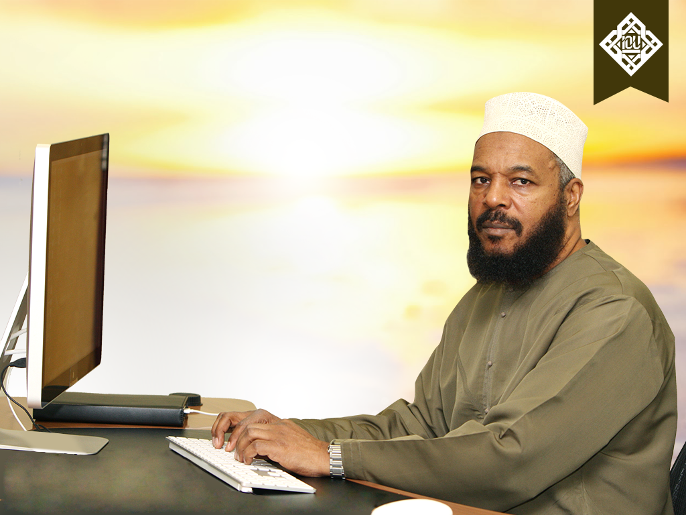
Founder
Dr. Bilal Philips
Jamaican – Canadian Islamic Scholar
Converted to Islam in early 70’s
BA Madeenah, MA Riyadh, PhD UK
Taught Arabic and Islamic Studies in High
Schools and Universities for 20 years
Set up Islamic Studies departments
Founded universities
Authored over 50 published books
One of the 500 most influential Muslims
in the world
www.iou.edu.gm

Slide 5
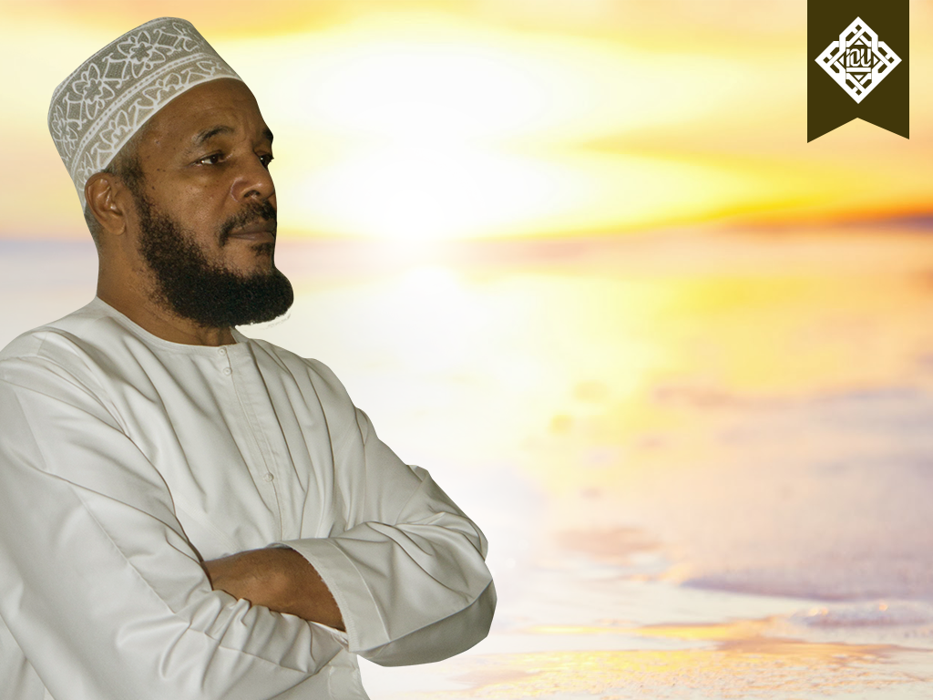
“Making authentic Islamic knowledge readily available to the world through the medium of the Internet solely for God’s pleasure is a noble goal and a dignified mission worthy of sacrificing one’s energies and means for.”
- Dr. Bilal Philips
www.iou.edu.gm

Slide 6

Mission
Authenticity
Accessibility
Affordability
Islamic Ethics
Community
Quality and Application
www.iou.edu.gm

Slide 7
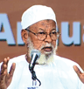
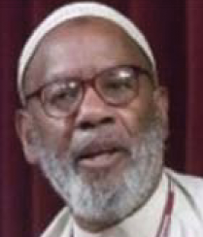
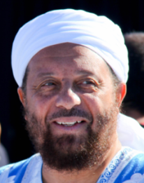
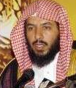
Advisory Committee
Dr. Jafar Shaikh Idrees
(Sudan)
Founder of the American
Open University, Washington, USA
Dr. James Jones
(USA)
Chair of World Religions,
Manhattanville College, USA
Dr. Abdul Hakim Quick
(Canada)
Peace University,
South Africa
Dr. Ibrahim Al-Nu’aimi
(Qatar)
Former Chancellor of
Qatar University
Dr. Saad Al-Shithri
(Saudi Arabia)
Founder of Knowledge
International University, Riyadh
www.iou.edu.gm

Slide 8
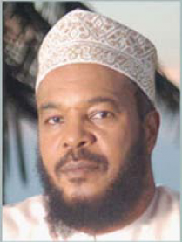
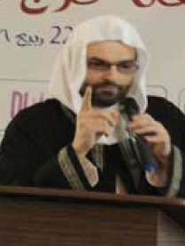
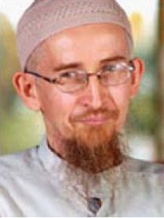
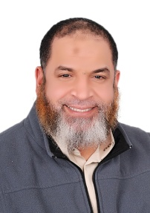
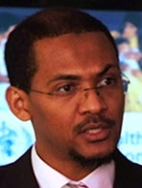
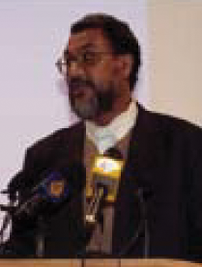

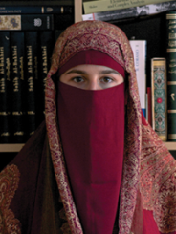
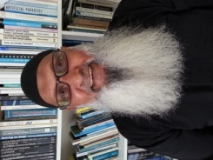
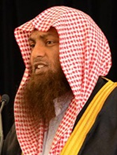
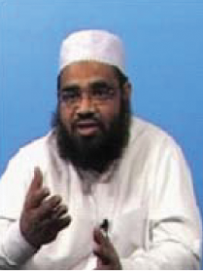

Instructors
Dr. Bilal Philips,
JAMAICA, W.I.
PhD
AQEEDAH
Wissam El Tom
LEBANON
MA
TAJWEED
Riaz Ansary
USA
PhD CANDIDATE
USOOL AL-FIQH
Daud Abdullah
GRENADA, W.I.
PhD
SEERAH
Karim Abu Zaid
Egypt
PhD
USOOL AL-HADEETH
Altijani Hussin
SUDAN
MA
ISLAMIC ECONOMICS
James Jones
USA
D.Min, PhD
COMPARATIVE
RELIGION
Dr G Hussein Rassool
Mauritius
PhD
PSYCHOLOGY
Francesca Bocca
ITALY
PhD
CHILD PSYCHOLOGY
IN ISLAM
M Anwar Sahib
FIJI
PhD
FIQH
Abdussalam Ghouse
INDIA
MA
HADEETH
Edo Omercevic
BOSNIA
MEC, BEcon
ISLAMIC BANKING
& ECONOMICS

Slide 9

IOU
DEPARTMENTS
& PROGRAMS
www.iou.edu.gm

Slide 10

Department of Islamic Studies
Department of Education
Department of Islamic Economics, Banking & Finance
Department of Psychology
Department of Business Administration
Department of Information Technology
Department of Arabic Language and Linguistics
Department of English Language and Linguistic
Global Qur’an Memorization Center
General Diploma in Islamic Studies
www.iou.edu.gm

Slide 11

Department
Of
Islamic
Studies
www.iou.edu.gm

Slide 12

Bachelor of Arts in
Islamic Studies (BAIS)
BAIS Degree
  High school diploma prerequisite
  Part time or full time – Flexible pace
  Maximum twelve years
BAIS content
  Core courses in Sharee’ah plus Da’wah supplement
  Additional 5 Modern core course areas: Education, Psychology, Finance, Management & ICT
www.iou.edu.gm

Slide 13

Master’s degree
Program in
Islamic Studies (MAIS)
Prerequisites:
BA in Islamic Studies from
an accredited institution
BA (in a subject other than
Islamic Studies), e.g. B.Sc.,
B.Com, or equivalent with
BMAIS diploma from IOU
Features:
Tuition-free
Completely online
English medium
Two to six years
15 courses + MA thesis
www.iou.edu.gm

Slide 14

Higher Diploma
Bridge to MA (BMAIS)
Prerequisite for joining IOU’s MA in Islamic Studies (MAIS) for those having Bachelor degrees in fields other than Islamic studies.
www.iou.edu.gm

Slide 15

Department of
Education
www.iou.edu.gm

Slide 16

Bachelor of Education (B.Ed.)
  B.Ed. Degree
  Part time or full time – Flexible pace
  High school diploma prerequisite
  Maximum twelve years
  B.Ed. Contents
  Conventional Subjects taught comparatively
  Core Islamic Studies subjects also taught
  Teacher training included
Diploma in Education
High School degree prerequisite
Two Year duration
Certificate in Education
High School degree prerequisite
One Year duration
www.iou.edu.gm

Slide 17

Department of
Islamic Economics,
Banking & Finance
www.iou.edu.gm

Slide 18

Bachelor of Science in Islamic Economics, Banking & Finance
(B.Sc. IBE)
B.Sc. IBE Degree
Part time or full time – Flexible pace
High school diploma prerequisite
Maximum twelve years
B.Sc. IBE Contents
Conventional Subjects taught comparatively
Core Islamic Studies subjects also taught
Associate Degree in Banking & Finance
High School degree prerequisite
Two-year duration
Certificate in Banking & Finance
High School degree prerequisite
One-year duration
www.iou.edu.gm

Slide 19

Department of
Psychology
www.iou.edu.gm

Slide 20

Bachelor of Science in Psychology
(B.Sc. PSY)
B.Sc. Degree
Part time or full time – Flexible pace
High school diploma prerequisite
Maximum twelve years
B.Sc. PSY Advanced Diploma
Conventional Subjects taught comparatively
Core Islamic Studies subjects also taught
Associate Degree in Psychology
High School degree prerequisite
Two-year duration
Certificate in Psychology
High School degree prerequisite
One-year duration
www.iou.edu.gm

Slide 21

Department of
Information
Technology
www.iou.edu.gm

Slide 22

Bachelor of Science in Information Technology (B.Sc. IT)
Part time or full time – Flexible pace
High school diploma prerequisite
Maximum twelve years
Associate Degree in IT
High School degree prerequisite
Two-year duration
Certificate in IT
High School degree prerequisite
One-year duration
  Contents
  Conventional Subjects taught comparatively
  Core Islamic Studies subjects also taught
  Islamic Ethics added
www.iou.edu.gm

Slide 23

Department of
Business Administration
www.iou.edu.gm

Slide 24

Bachelor of Science in Business Administration (BBA)
Part time or full time – Flexible pace
High school diploma prerequisite
Maximum twelve years
Associate Degree in Business Administration
High School degree prerequisite
Two-year duration
Certificate in Business Administration
High School degree prerequisite
One-year duration
Contents
Conventional Subjects taught comparatively
Core Islamic Studies subjects
www.iou.edu.gm

Slide 25

Department of
Arabic Language
& Linguistics
www.iou.edu.gm

Slide 26

Bachelor of Arts in Arabic Language and Linguistics
BA ARB Degree
  Part time or full time – flexible pace
  4-year program; maximum twelve years
  based on courses taught at Imam Muhammad bin Saud University in the Kingdom of Saudi Arabia
  High school diploma prerequisite
Detailed Arabic Grammar
Arabic Literature -- pre-Islamic, Islamic, Modern
In-depth Al-Madinah series of books
Arabic Rhetoric, Linguistics, and Morphology
www.iou.edu.gm

Slide 27
Intensive Arabic program
Duration: Two year intensive
Focus on:
Reading
Writing
Listening
Speaking
www.iou.edu.gm

Slide 28


  Requirements:
  above the age of 12 years
  proficient in reading Arabic language or Arabic 100
  knowledge of the basic rules of Tajweed
  reasonable ability to recite Qur’an with Proper Tajweed
  high speed Internet connection
  Tuition-free | Flexible study | Female Teachers
www.iou.edu.gm

Slide 29

General Diploma
in Islamic Studies
  IOU offers over 40 courses at a small
  subscription fee of as little as $1 per month
  No minimum requirements
  Flexible and organized study
  Certificate upon completion of each course
  Diploma upon completion of 24 courses
www.iou.edu.gm

Slide 30

Enrollment
& Fees
Tuition-Free
Semester Enrollment Fee:
US $110 – US $320
Based on student country
of residence.
Part time and Accelerated study plans available.
www.iou.edu.gm

Slide 31


ACCREDITATION
www.iou.edu.gm

Slide 32




Directorate of Higher Education, Somali Federal Republic
The Somali Federal Republic, Ministry of Public and Human Services through the Directorate of Education, Culture and Higher Education granted a university license and accreditation to the International Open University in July 2013.
Ministry of Higher Education, The Gambia
The Ministry of Higher Education granted a provisional university license of operation to the International Open University in May 2014.
National Accreditation and Quality Assurance Authority (NAQAA)
The National Accreditation and Quality Assurance Authority (NAQAA) has granted the International Open University a three years Provisional License to operate as a higher education institution in The Gambia with effect from 29 April, 2019. This license also serves as an institutional accreditation of International Open University, the Gambia, by National Accreditation and Quality Assurance Authority.
National Council for Technical, Vocational and other Technical Awards (NCTVA)
National Council for Technical, Vocational and other Technical Awards (NCTVA in Sierra Leone has granted accreditation.
Present status: Accreditation under renewal.
www.iou.edu.gm

Slide 33

CONTACT
International Open University
21 Kanifing Mosque Road,
P.O. Box 2340,
Kanifing South, KMC,
The Gambia.
Tel: +220-9666612
Admissions & General Enquiry:
info@iou.edu.gm
www.iou.edu.gm

Slide 34

Q& A
www.iou.edu.gm

